Slide 1
setwd("D:/dudwlsrla92/Assignment/[과제 6] wordcloud_pie_bar_graph")
getwd()
install.packages('KoNLP')
install.packages('tm')
install.packages('rjava')
install.packages('wordcloud')
install.packages('ggplot2')
install.packages('dplyr')
library(KoNLP)
library(tm)
library(rJava)
library(wordcloud)
library(ggplot2)
library(dplyr)
useSejongDic()
# 1. 데이터 불러오기
hiphop <- readLines("hiphop.txt")
# 2. 데이터 변환하기
hiphop_corp <- Corpus(VectorSource(hiphop))
inspect(hiphop_corp)
# 3. 불필요한 단어 제거
hiphop_corp2 <- tm_map(hiphop_corp,stripWhitespace)
hiphop_corp2 <- tm_map(hiphop_corp2,tolower)
hiphop_corp2 <- tm_map(hiphop_corp2,removeNumbers)
hiphop_corp2 <- tm_map(hiphop_corp2,removePunctuation)
sword2 <- c(stopwords('en'),'and','but','not') # 영어의 관사 대명사 접속사 등
hiphop_corp2 <- tm_map(hiphop_corp2,removeWords,sword2)
inspect(corp3)
inspect(corp3)
# 4. 명사 추출.
hiphop_nouns <- sapply(hiphop_corp2,extractNoun, USE.NAMES = F)
hiphop_nouns
head(unlist(hiphop_nouns),30)
hiphop_nouns_unlist <- unlist(hiphop_nouns)
hiphop_nouns_unlist
# 5. 걸러내기
hiphop_filter <- Filter(function(x){
nchar(x) >= 2 & nchar(x) <= 6},
hiphop_nouns_unlist)
head(hiphop_filter,20)
txt <- readLines("hiphop_gsub.txt")
for(i in 1:length(txt)){
hiphop_filter <- gsub((txt[i]),"",hiphop_filter)
}
# 6. 저장 + read.table
write(unlist(hiphop_filter),"hiphop_final.txt")
hiphop_final <- read.table('hiphop_final.txt') ;
#nrow(hiphop_final) #제거 확인.
## 6. 명사의 개수와 추가적으로 제거할 명사 구분.
wordcount <- table(hiphop_final) ; wordcount
head(sort(wordcount, decreasing=T),20)

Slide 2
# 연습문제 1번 wordcloud 만들기.
windowsFonts(baedal=windowsFont("배달의민족 도현"))
palete <- brewer.pal(10,"Set3")
par(bg="black")
wordcloud(names(wordcount),
freq=wordcount,
scale=c(4,0.3),
min.freq=1,
max.freq=100,
colors=palete,
random.order=F,
random.color=F,
family="baedal")
legend(0.3,0.9,
"1번 hiphop_WordCloud 만들기 ",
cex=0.8,
fill=NA,
border=NA,
bg="white",
text.col="red",
text.font=2,
box.col="red")

Slide 3
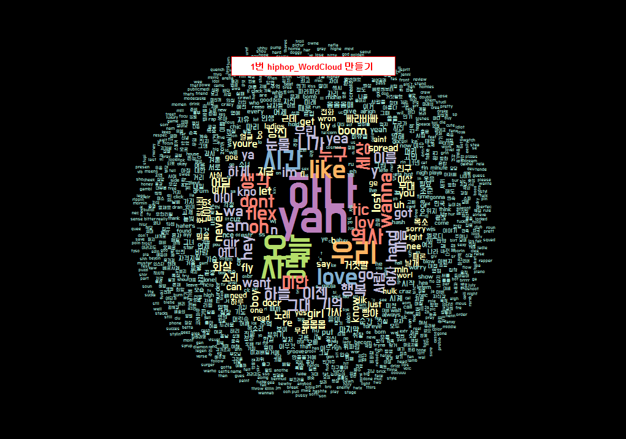

Slide 4
# 연습문제 2번 Top 10 단어에 대해서 원 그래프 만들기.
top10 <- head(sort(wordcount,decreasing = T),10)
str(top10)
df_top10 <- as.data.frame(top10)
library(dplyr)
options(digits = 2)
df_top10 <- df_top10 %>%
mutate(pct= round(Freq / sum(Freq)*100,1)) %>%
mutate(ylabel = paste0(hiphop_final,'\n',Freq,'개')) %>%
arrange(desc(hiphop_final))
df_top10
par(bg="black")
ggplot(df_top10,aes(x='',y=Freq,fill=hiphop_final, family='baedal')) +
geom_bar(width=1, stat='identity') +
geom_text(aes(y=ypos,label=ylabel),color='black',size=5) +
coord_polar("y",start=0) +
ggtitle('2번 Hiphop.txt_Top10 원그래프') +
theme_bw(base_family="baedal",base_size = 15) +
theme(plot.title = element_text(family="baedal",
face = "bold",
hjust = 0.5,
size = 25,
color = "darkblue"))

Slide 5
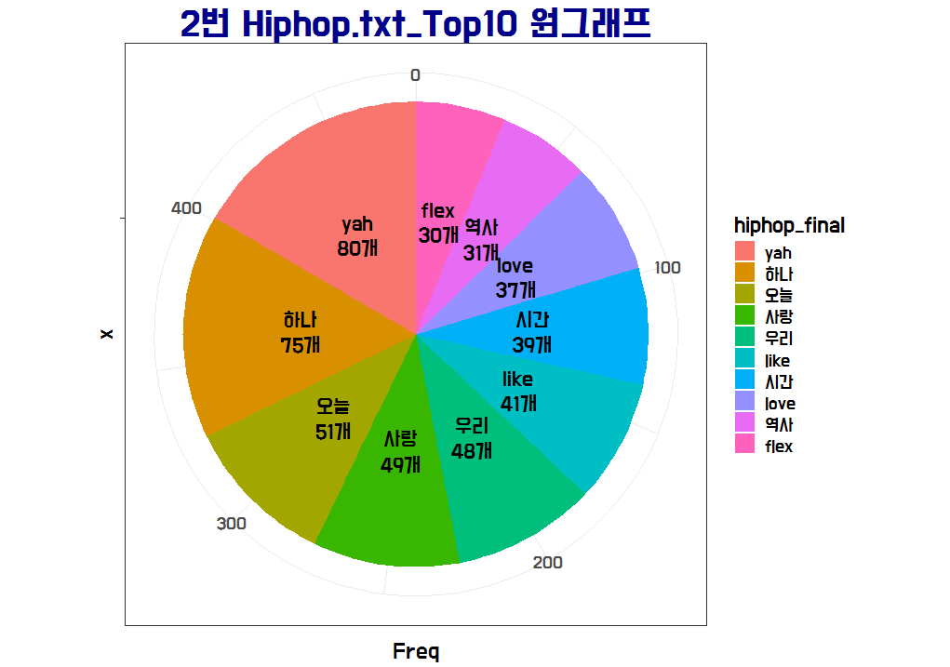

Slide 6
# 연습문제 3번 Top 10 단어에 대해서 막대 그래프 만들기.
df_top10 <- df_top10 %>%
mutate(pct= round(Freq / sum(Freq)*100,1)) %>%
mutate(ylabel = paste0(hiphop_final,'\n',Freq,'개')) %>%
arrange(desc(hiphop_final))
df_top10
ggplot(df_top10,aes(x=hiphop_final,y=Freq,fill=hiphop_final)) +
geom_bar(width=0.9, stat='identity') +
ggtitle('3번 Hiphop.txt_Top10 막대그래프') +
theme_bw(base_family="baedal",base_size = 15) +
geom_text(aes(y=Freq, label=ylabel), color='black',family="baedal",size=5)+
theme(plot.title = element_text(family="baedal",
face = "bold",
hjust = 0.5,
vjust = 2,
size = 30,
color = "darkblue"))

Slide 7
